Slide 1

SWAKOPMUND SECONDARY SCHOOL
GRADE 11 COMPUTER STUDIES NOTES
TOPIC: DATABASES
Mr Kanhalelo

Slide 2
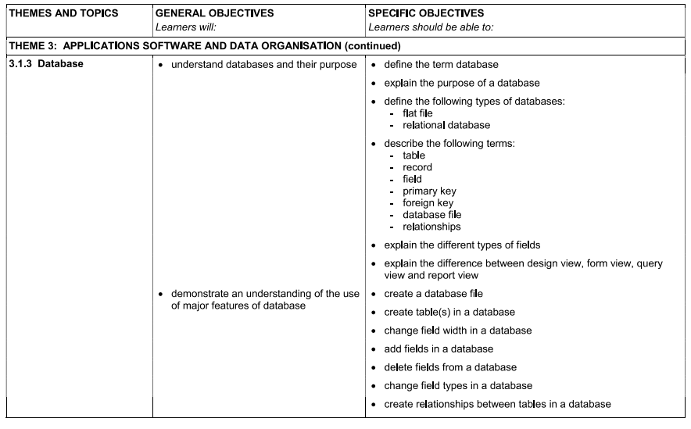

Slide 3
What is a Database?
A database is a systematic collection of data.
Databases support electronic storage and manipulation of data. Databases make data management easy.
example: An online telephone directory uses a database to store data of people, phone numbers, and other contact details.
Your electricity service provider uses a database to manage billing, client-related issues, handle fault data.
Companies like Meta, Google, and Netflix all use databases to store large volumes of data.

Slide 4
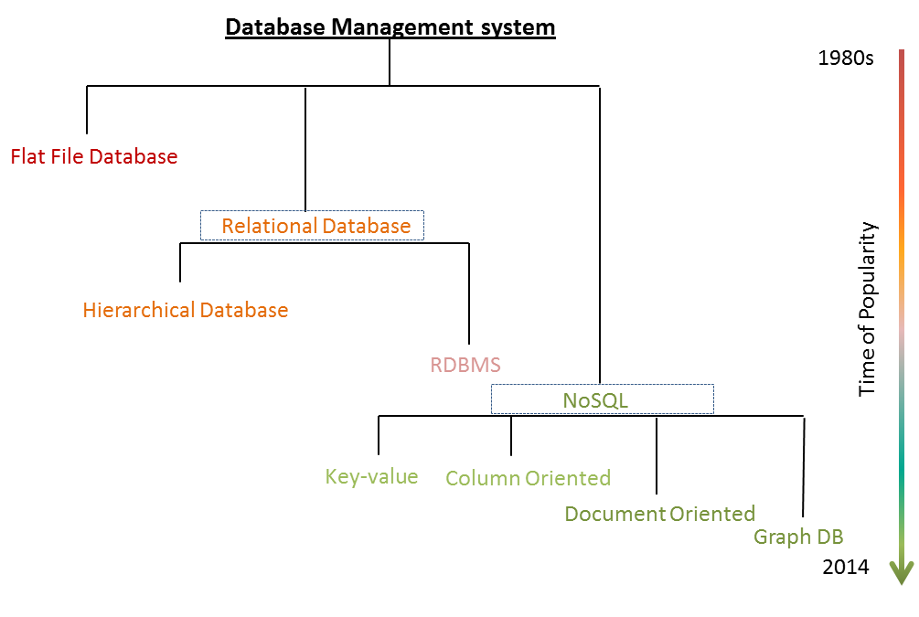
Present

Slide 5
What is the purpose of a Database?
offers a variety of techniques to store & retrieve data.
serves as an efficient handler to balance the needs of multiple applications using the same data
Offers Data Integrity and Security.
Uniform administration procedures for data.
Uniform administration procedures for data.

Slide 6
Types of Databases?
A flat-file database:
is a database stored in a file called a flat file.
Records follow a uniform format, and there are no structures for indexing or recognizing relationships between records. The file is simple.
Examples: csv, txt or tsv or a binary file.
Relational databases:
A relational database is a collection of data items with pre-defined relationships between them.
These items are organized as a set of tables with columns and rows.
Examples: MySQL, Oracle, and Microsoft SQL Server database.

Slide 7
Technical terms
Table:
A table is a data structure that organizes information into rows and columns.
Record:
A record is a database entry that may contain one or more values.
Groups of records are often called rows since each new record creates a new row in the table.
Field:
a field is a data structure for a single piece of data
Primary Key:
A primary key is a unique identifier for a database record.
Foreign Key:
Is a column (or group of columns) used in a relational database to link data between tables

Slide 8
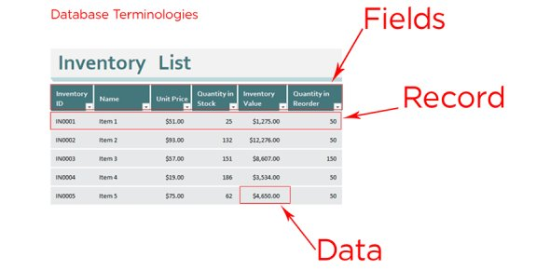

Slide 9

MS ACCESS

Slide 10
What is Microsoft Access?
Microsoft Access is a Database Management System offered by Microsoft. It uses the Microsoft Jet Database Engine and comes as a part of the Microsoft Office suite of application.
Microsoft Access offers the functionality of a database and the programming capabilities to create easy to navigate screens (forms). It helps you analyze large amounts of information, and manage data efficiently.

Slide 11
Important Terms and Basic Objects
Database File:
It is a file which stores the entire database. The database file is saved to your hard drive or other storage devices.
Data types:
Datatypes are the properties of each field. Every field has one data type like text, number, date, etc.
Table
A Table is an object which stores data in Row & Column format to store data.
A Table is usually related to other tables in the database file.
Each column must have Unique name
We can also define Primary Key in a table.

Slide 12
Query
Queries answer a question by selecting and sorting and filtering data based on search criteria.
Queries show a selection of data based on criteria (limitations) you provide.
Queries can pull from one or more related Tables and other Queries.
Types of Query can be SELECT, INSERT, UPDATE, DELETE.

Slide 13
Form
A form is a database object that you can use to create a user interface for a database application.
Forms help you to display live data from the table. It mainly used to ease the process of data entry or editing.
Report
A report is an object in desktop databases primarily used for formatting, calculating, printing, and summarizing selected data.
You can even customize the report’s look and feel.
Macros
Macros are mini computer programming constructs. They allow you to set up commands and processes in your forms, like, searching, moving to another record, or running a formula.
Modules:
Modules are procedures(functions) which you can write using Visual Basic for Applications (VBA).

